Slide 1
Programming Language Constructs

Slide 2
Types of language constructs
There are different types of language constructs as follow
Variable
Expression
Data types
Literals
Statement
Operator

Slide 3
Variable
In C++ variable is used to store data in a memory location, which can be modified or used in the program during program execution. Variables play a significant role in constructing a program, storing values in memory and dealing with them. Variables are required in various functions of every program

Slide 4
Expression
A combination of variables, constants and operators that represents a computation forms an expression. Depending upon the type of operands involved in an expression or the result obtained after evaluating expression

Slide 5
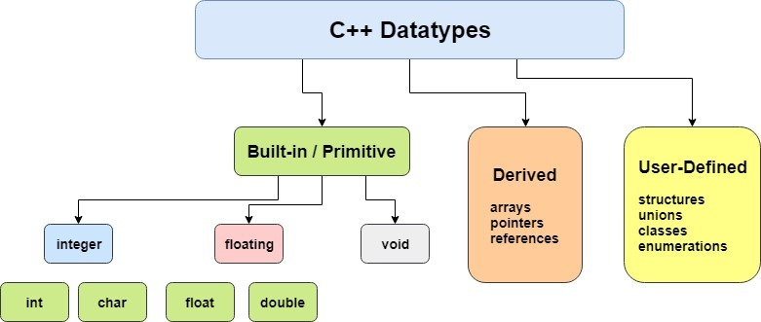
Data types
C++ Data Types. ... You may like to store information of various data types like character, wide character, integer, floating point, double floating point, boolean etc. Based on the data type of a variable, the operating system allocates memory and decides what can be stored in the reserved memory. There are different types of data types as shown in picture

Slide 6
Literals
Constants/Literals. Constants refer to fixed values that the program may not alter and they are called literals. Constants can be of any of the basic data types and can be divided into Integer Numerals, Floating-Point Numerals, Characters, Strings and Boolean Values.

Slide 7
STATEMENT
A simple C++ statement is each of the individual instructions of a program, like the variable declarations and expressions seen in previous sections. They always end with a semicolon (;), and are executed in the same order in which they appear in a program.But programs are not limited to a linear sequence of statements. During its process, a program may repeat segments of code, or take decisions and bifurcate. For that purpose, C++ provides flow control statements that serve to specify what has to be done by our program, when, and under which circumstances. The types of statements are as follow 1) expression statements;
2) compound statements;
3) selection statements;
4) iteration statements;
5) jump statements;
6) declaration statements;

Slide 8
Operators
An operator is a symbol that tells the compiler to perform specific mathematical or logical manipulations. C++ is rich in built-in operators and provide the following types of operators −
Arithmetic Operators
Relational Operators
Logical Operators
Bitwise Operators
Assignment Operators
Misc Operators

